Slide 1

Heuristics are utilized in an AR & VR Apps
-VR App: Sites in VR : A virtual reality application available on apple store.
About :
App provides many sites like city famous places captured in 3d those can be viewed on wide type of Virtual Reality headsets.

Slide 2
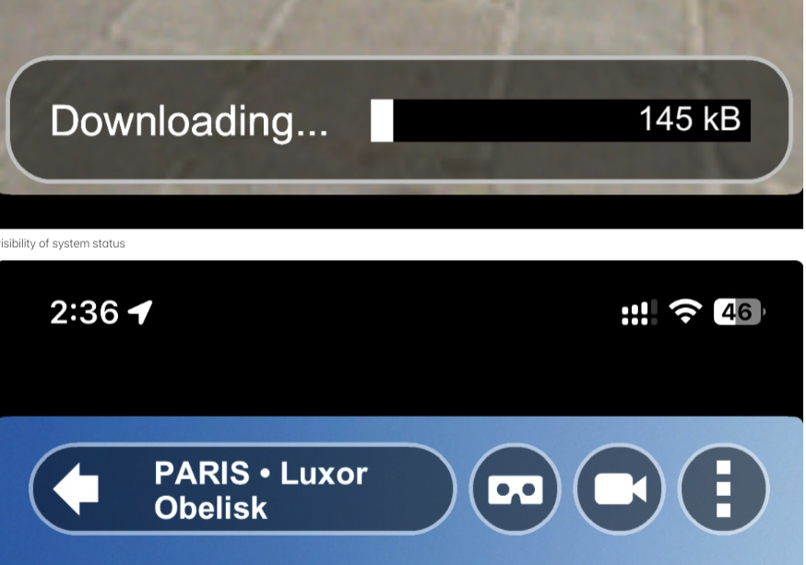
Visibility of system status :
Download progress bar is shown when we are trying to open a new location -keeps inform about the system status
Similarly all the device network information etc are visible when we open the application.

Slide 3
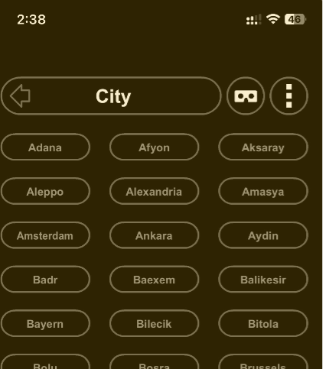
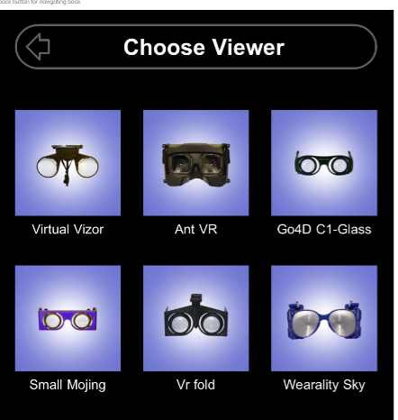
Real world naming conventions are used in city header and names
Match between system and the real world :
Chose viewer easy to understand header
Real device names

Slide 4

User control and freedom,Consistency and standards
Consistent UI with back button, with black and white high contrast icon.
User is having option for back navigating.

Slide 5
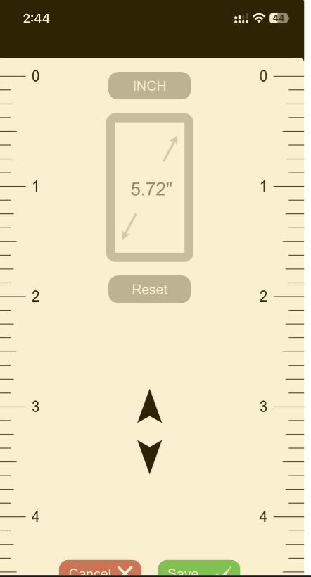
Error prevention and User control and freedom
User have the option to reset system incase if they mess up with settings.

Slide 6
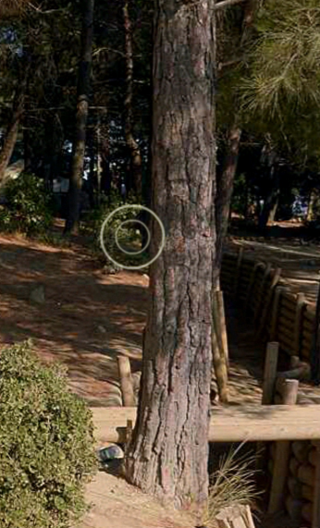
Flexibility and efficiency of use
Circle showing zoomable location or we can go to the location clicking on the circle.

Slide 7
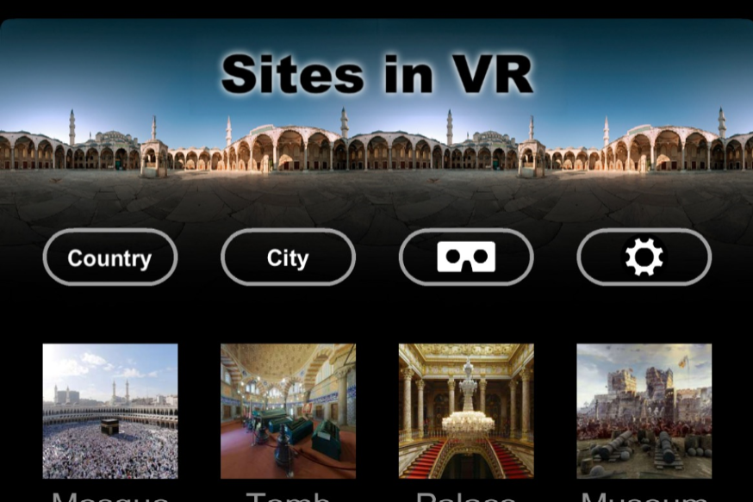
Aesthetic and minimalist design
Square minimal design with visible texts

Slide 8
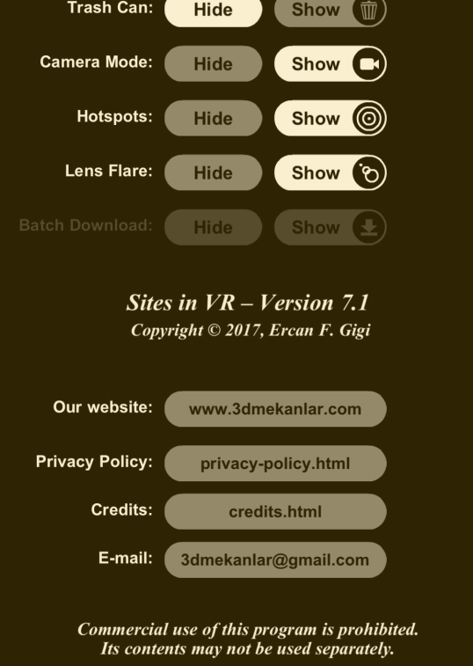
Email Address is provided in the app.
Email address of developer is provided incase of any issue.

